Slide 1
Implementation of Kernel function based on Ramanujam sums for computer vision to diagnose pulmonary diseases CS 512 – Computer Vision Rakshith Churchagundi Amarnath Megha Tatti CWID: A20424771 CWID:A20427027

Slide 2
The problem? Pulmonary disease detection > Failure in diagnosis > Failure to detect in time > Failure in monitoring strategies

Slide 3

Remedy AI enabled medical imaging > Helps pathologists to interpret the patients data more effectively. > assists physicians to obtain a better picture of patients’ prognosis.

Slide 4



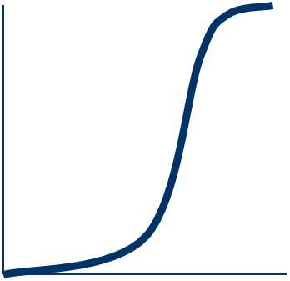
Actions What are edges in an image ? > Edges are those places in an image that correspond to object boundaries. > Edges are pixels where image brightness changes abruptly. Brigntness Spatial

Slide 5
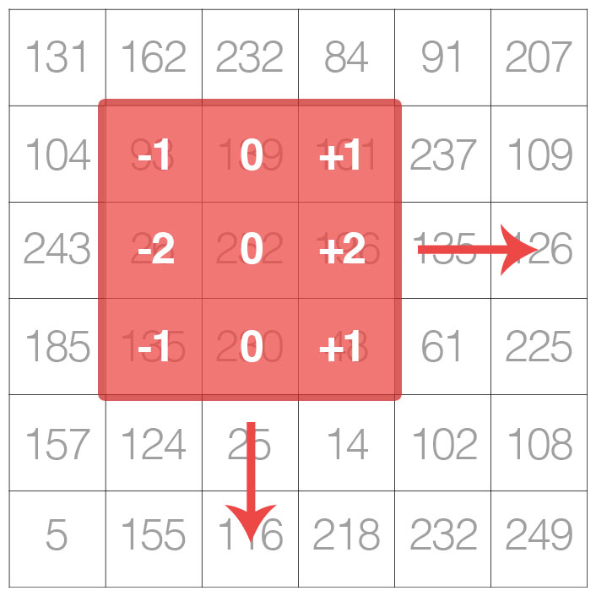
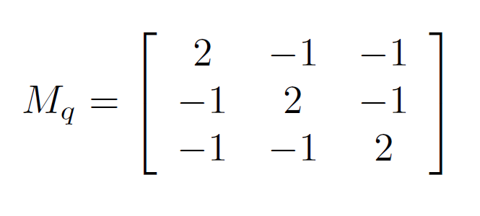
Using Computer Vision Methods
Image Kernels RS Kernel Matrix for 2nd order

Slide 6
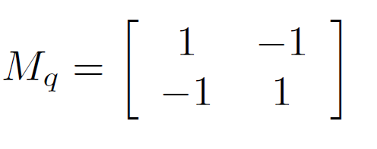
Procedure We have the kernel matrix corresponding to the q = 1 as It means that Ramanujan image kernel can be used as gradient matrix.
Ramanujam sums
X gradient image kernel [-1, 1]
Y gradient image kernel 1
-1

Slide 7
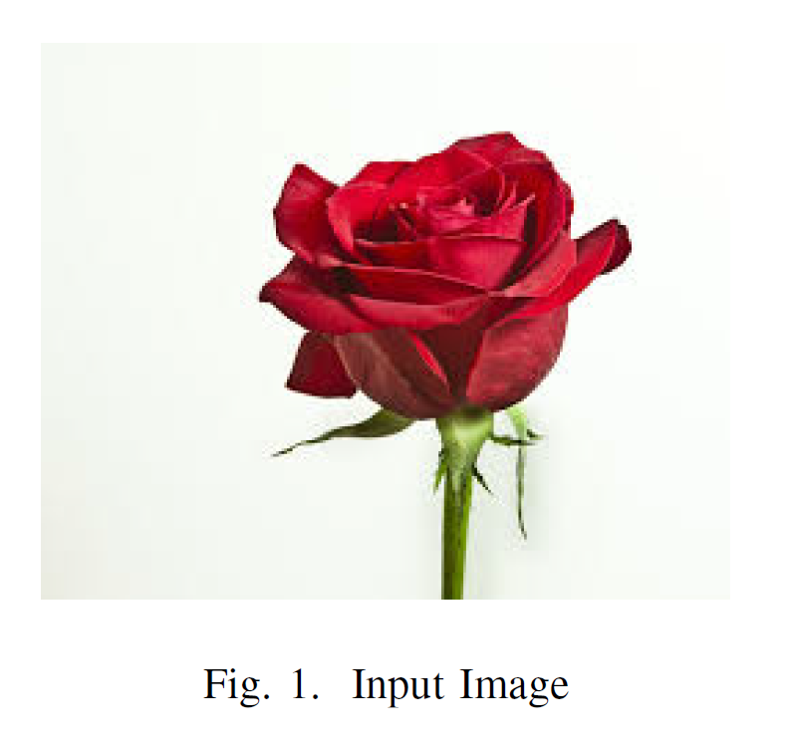
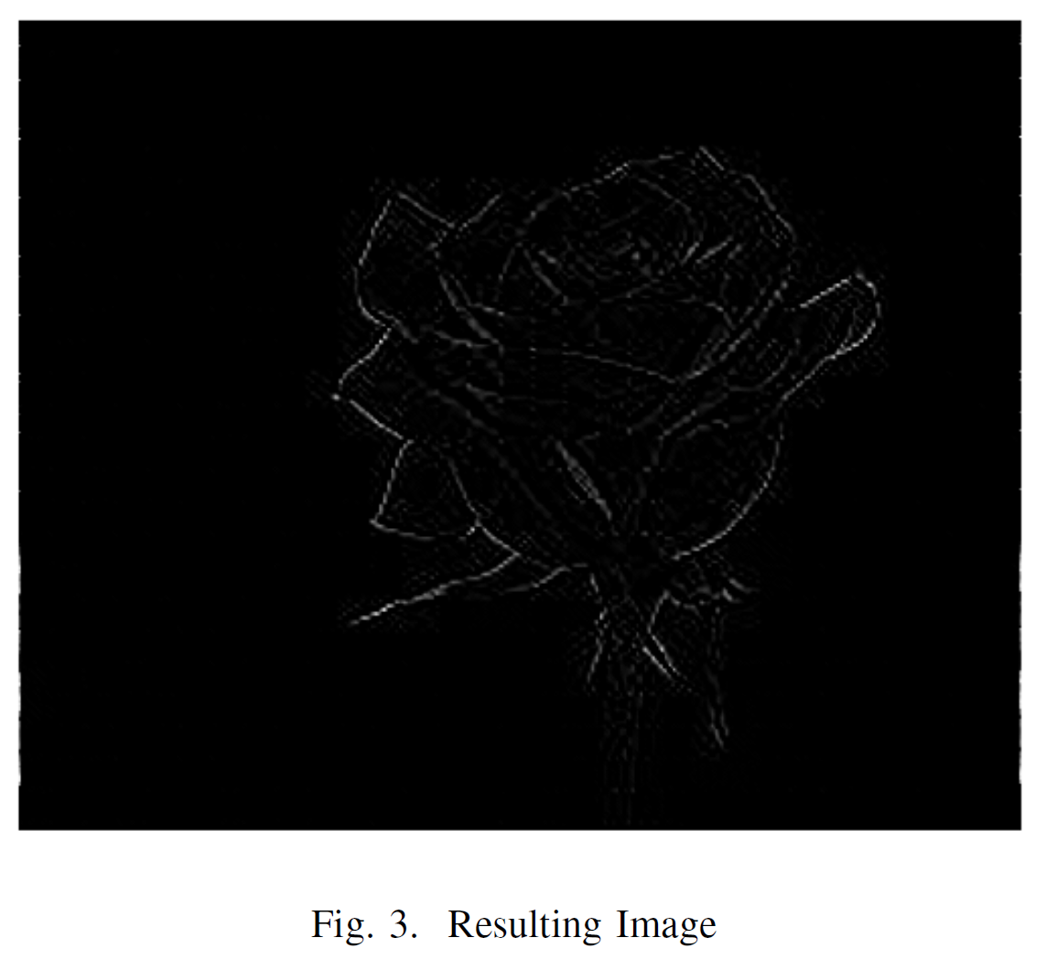
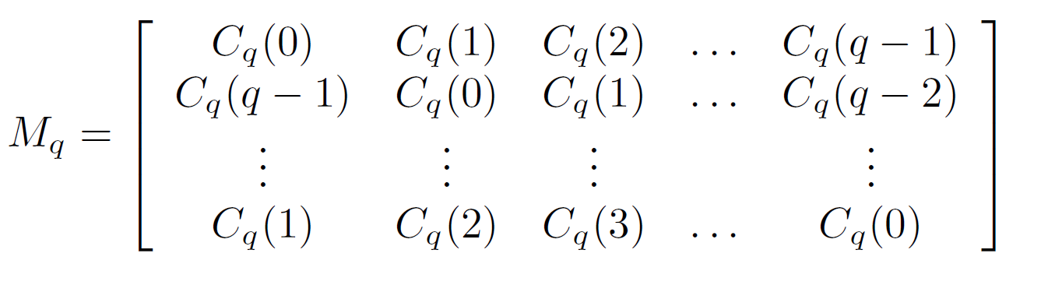
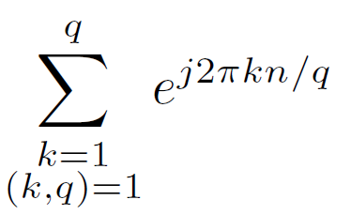
Image to Edge map
Edge Detection Using RS Kernel

Slide 8
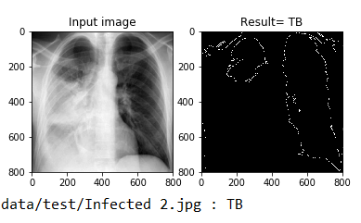
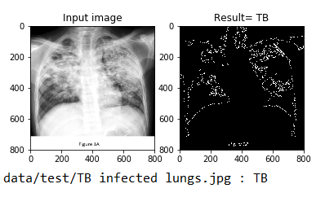
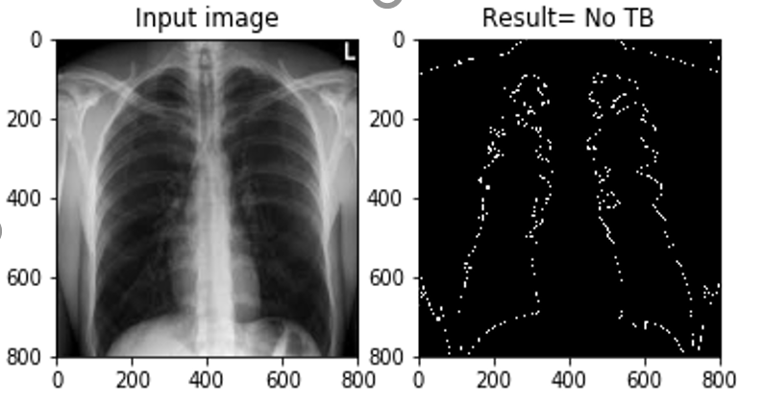
Results Left Top Ruptured (TB infected) Ripped lungs (TB infected) Lungs Intact (Healthy)

Slide 9
Applications
using 3rd order kernel matrix, can be applied in the health care sector, where accuracy and precise image detection is of utmost importance.
Promising Results: Since the new kernel is entirely based on the numerical computations.

Slide 10



Thank You ☺ Any Questions??

